Slide 1

Ideal Location for Chinese restaurant in Toronto
IBM Data science –Capstone Project
By: Mun Yee

Slide 2

business problem
Opening a new Chinese restaurant in big city like Toronto
Existing restaurants present in the city making it a tougher task to success in this field.
Factors that may affect the success of the business:
1. Population
2. Ability and willingness to spend
3. Competition with other restaurant
4. Quality of food and type of cuisine
Which areas are the best options to open a new Chinese Restaurant in Toronto???

Slide 3



Data Source
Data
Foursquare API
Number of Restaurants in Each Neighbourhood
Number of Chinese Restaurants in Each Neighbourhood
Latitude and Longitude of Each Neighbourhood
Toronto Census
Population & Ethnic Distribution of Each Neighbourhood
Income Distribution of Each Neighbourhood

Slide 4
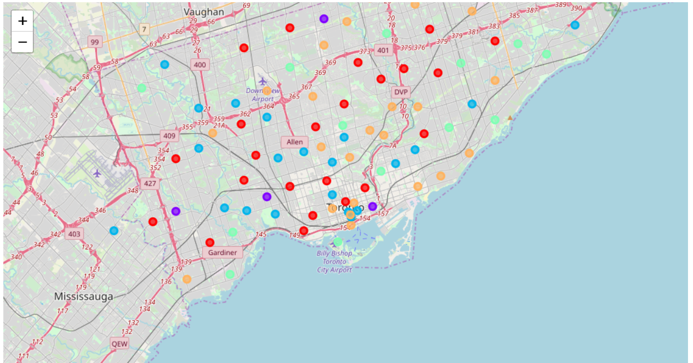

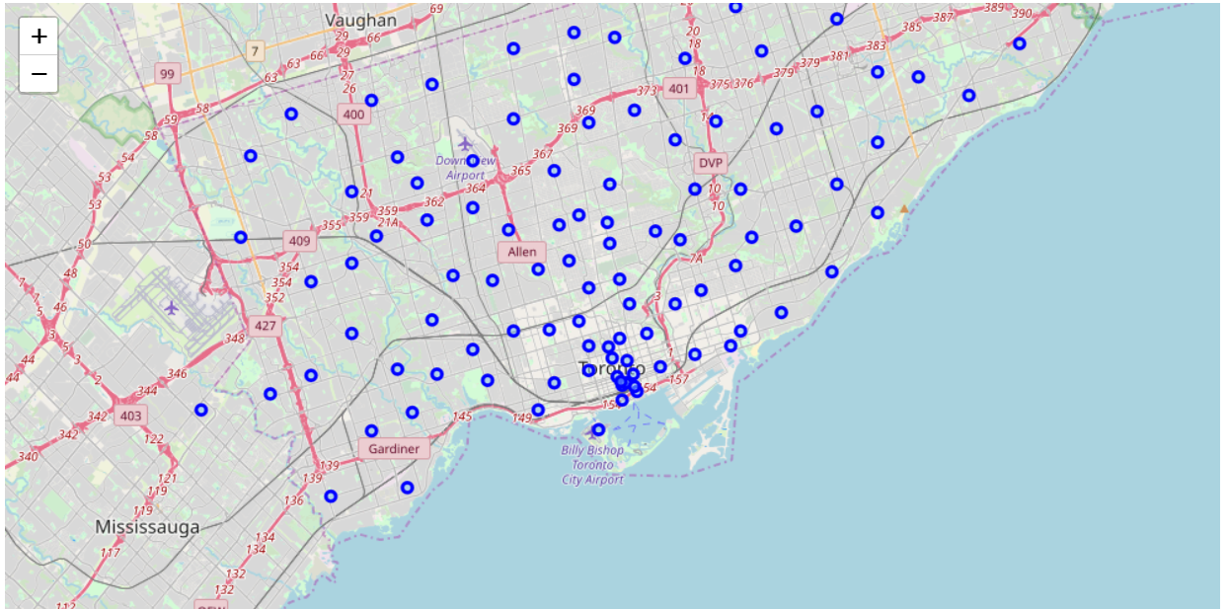

Clustering
Toronto
Cluster 0 = Red
Cluster 1 = Purple
Cluster 2 = Blue
Cluster 3 = Turquoise
Cluster 4 = Orange
After clustering

Slide 5
Characteristic of each cluster
Cluster Label | Characteristics
0 | Low population, low spending power (-0.4 to 0.6), various % of restaurant, area and Chinese
1 | Generally high population, high spending power (1.7 to 3.8), various % of area and Chinese. Scarborough has the highest no. of Chinese restaurant in this cluster (n=16)
2 | Low population and extremely low spending power (negative)
3 | Average size of population and average spending power (0.2- 1.7)
4 | Low population and low spending power (negative to 0.2)

Slide 6
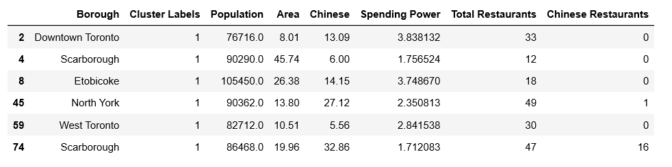
Details of neighbourhood in Cluster 1

Slide 7
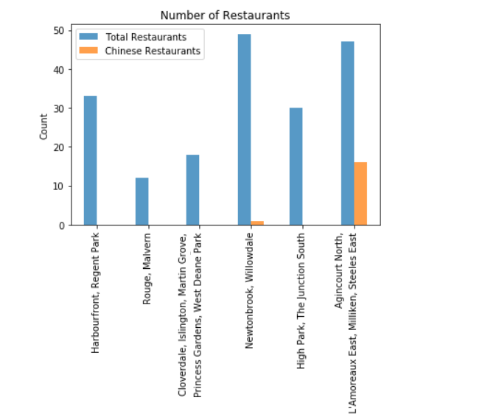
Total No. of restaurant & Chinese restaurant
Top TWO locations of choice:
i. Rouge, Malvem
- Least number of restaurants (n=12)
- No Chinese restaurant in the area
ii. Cloverdale, Islington, Martin Grove, Princess
Gardens, West Deane Park
- Low number of restaurants (n=18)
- No Chinese restaurant in the area

Slide 8
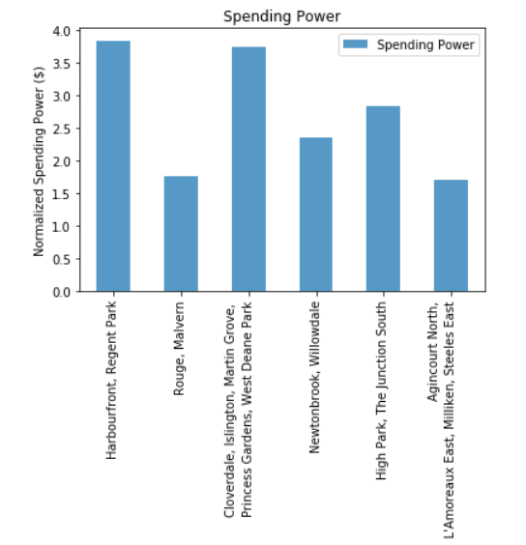
Spending Power of each neighbourhood
Top TWO locations of choice:
i. Harbourfront, Regent Park
- Highest spending ability in the region
ii. Cloverdale, Islington, Martin Grove, Princess
Gardens, West Deane Park
- Second highest spending ability in the region

Slide 9
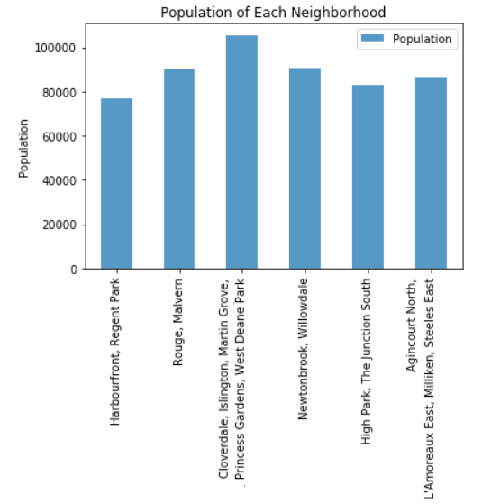
Population of each neighbourhood
Top TWO locations of choice:
i. Cloverdale, Islington, Martin Grove, Princess
Gardens, West Deane Park
- Largest population in the region hence the
demand may be higher
ii. Newtonbrook, Willowdale
- Second largest in the region

Slide 10
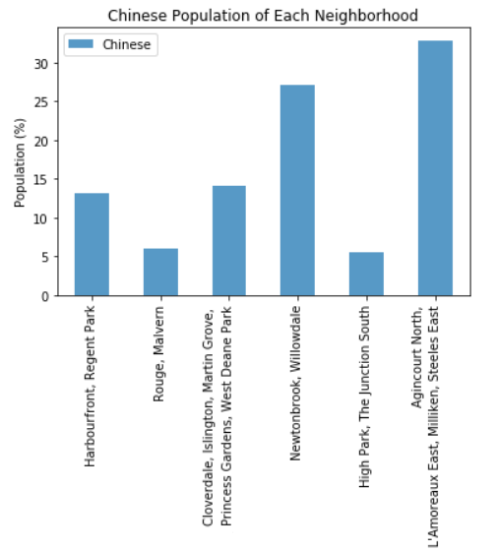
Chinese population of each neighbourhood
Top TWO locations of choice:
i. Agincourt North, L’ Amoreeaux East, Milliken,
Steeles East
- Has the highest percentage of Chinese in the area
ii. Newtonbrook, Willowdale
- Second highest in the area
** (Cloverdale, Islington, Martin Grove, Princess
Gardens, West Deane Park) came in 3rd place

Slide 11
The most ideal locations:
Borough:
Etobicoke
Neighbourhoods:
Cloverdale, Islington, Martin Grove, Princess Gardens, West Deane Park
This area has the largest population, 2nd lowest in total number of restaurants, 2nd highest spending power and 3rd highest % of Chinese population in the cluster

